Slide 1
Wine: A Poster Child for Globalization
March 5, 2013
Merton Finkler, Ph.D

Slide 2
Scottish Highland Cattle in California

Slide 3
Overview
The Past – Wine options circa 1970
Limited options, high quality wine was very expensive
The Present – Today’s wine options
Numerous options for high quality wine available
The Future – Conjectures about wine in 2050
Product, process, and price will evolve
Will most wine be delivered in barrels or botas, not bottles?
Will global warming make Wisconsin the wine capital of the US?

Slide 4
Globalization: It’s a Flat World
Globalization defined
Specialization: production is divided into component parts & produced where cheapest
Grape farming
Wine making
Distribution and sales
Consolidation: scale economics and lowest cost dictate the character of the supply chain & production
Result: more choice, better value
Wine comes from “Chateau Cash Flow”

Slide 5
Why is Wine a Poster Child for Globalization?
Changes in character of the product, the process of production and delivery and prices are driven by worldwide competition.
Evolution from a niche product with few identifiable segments to a continuum of products with good quality available at a good price in most places
Globalization brings a world of exciting wine experiences, but it also unleashes market forces that threaten to overwhelm the “soul” of wine.

Slide 6
Terroirism: The Response to Globalization
Terroirism claims that wine has a unique character based on where it is produced.
Soil+ Climate+ Area = Mystique
Wine’s “soul” comes from the physical attributes of the physical locale and the personality of that local culture

Slide 7
Wine and the Movies
Bottle Shock – California wines surprise French experts at a 1976 competition
Sideways- wine culture: merlot (for the masses) vs. pinot noir (for the elite)
Mondovino: The Revenge of the Terroirists
Fear of McWine movement
Importance of authenticity: appellation d’origine controllee
Reject global wine makers/consultants

Slide 8
Key Resources
Wine Wars: The Curse of the Blue Nun, the Miracle of Two Buck Chuck, and the Revenge of the Terrorists (Michael Veseth)
www.wineeconomist.com
The American Association of Wine Economists which produces the Journal of Wine Economics http://www.wine-economics.org/
The Box: How the Shipping Container Made the World Smaller and the World Economy Bigger (Marc Levinson)
Elliott Morss – Global Finance http://www.morssglobalfinance.com/judgments-of-paris-princeton-and-lenox-part-3/

Slide 9
Wine – Circa 1970
Most wines came from France, Germany, or California and were specific varietals – e.g., chardonnay or cabernet sauvignon
Vintners: grew grapes, made wine, and sold it.
The wine that came in a box was nasty and brutish.
Blends were white or red mix of left overs – marketed as chablis or burgundy
There were 579 wineries in the US
At least 1 winery in only 34 states
Wisconsin had 5 wineries
State Liquor Board monopolies controlled wine sales
Washington until 1969 treated California wine as foreign
Result: Poor quality & high prices

Slide 10
Wine circa 1995
Number of US wineries tripled to 1,817
All but 3 states had at least one winery
Wisconsin had 13 wineries
Few wine bars – concentrated in California and the Northeast
Blending of grapes for improved quality was still relatively rare.

Slide 11
Wine 2010 – US Background
There were 6,672 wineries in the US in 2010 (10 x 1975)
All fifty states had at least 2 wineries ; 41 states had at least 10 wineries
Wisconsin had 65 wineries (13x – 1975)
Some wine companies – e.g. Castle Rock (25th largest wine seller in US) - own no vineyard or winery.
35% of wine consumed in the US is imported

Slide 12
Effects of Globalization
Specialization means grape farming, wine making, and wine selling done by different organizations connected by a supply chain
Global wine makers common – Michel Rolland
One result: Two Buck Chuck – One Euro Aldi
Another result: Bottling and wine making need not take place near where grapes are grown; thus as Veseth puts it “Sell Local, Source Global”
Third result: Much wine is shipped in sealed blatters inside boxes and bottled by distributors for worldwide sale. (50% of New World exports)

Slide 13
This Wine Blatter Contains 24,000 liters or 32,000 bottles of enjoyment

Slide 14
Blends are Abundant and of Decent Quality
Some wineries give specific percentages
Meritage (Sterling) – 57% Cab S, 37% Merlot, …
80/20 (Stones Throw)
Some just identify the grapes
Cellar #8 from Asti Winery notes 8 varietals
Some just say it’s a blend
Kendall Jackson’s Summation – grapes originally from Loire and Rhone Valleys – sells for price similar to its Chardonnay.
Yellowtail – 650 different sources

Slide 15
Consolidation

Slide 16
World Wine Production (2010)
Most grapes grown between 30th and 50th latitudes
Country | Production (million liters) | % of World Total
France | 4,627 | 17.5%
Italy | 4,580 | 17.4%
Spain | 3,610 | 13.7%
United States | 2,653 | 9.9%
Argentina | 1,625 | 6.2%
Australia | 1,073 | 4.1%
China | 425 | 1.6%
Notes:
106 liters = 100 quarts

Slide 17
Vineyard Cost per Hectare
US and Europe - $50,000 per hectare for land suitable for vineyards ($20,000/ acre)
Established vineyards – up to $750,000/hectare
Argentina – land suitable - $10,000/ hectare and established vineyards– as low as $35,000/hectare
Languedoc – half million acres of vines over 30k wine makers, much of it subsidized by the EU and distilled into industrial alcohol
Conclusion: Given quality, it’s hard to compete with wine from Argentina, Australia & Chile
Notes:
1 Hectare = 2.47 Acres

Slide 18
World Wine Consumption (2010)
Country | Liters per capita | Total Consumption | World Share
France | 45.70 | 2,943 million | 12.5%
Italy | 42.15 | 2,449 million | 10.4%
Spain | 26.16 | 1,059 million | 4.5%
United States | 9.42 | 2,893 million | 12.3%
Argentina | 23.74 | 971 million | 4.1%
Australia | 24.93 | 531 million | 2.3%
China | 0.69 | 923 million | 3.9%
Notes:
Tables from the Wine Institute

Slide 19
Gaps – Production minus Consumption
Country | Gap | % of Production
France | 1.684 million | 36.3%
Italy | 2,131 million | 46.5%
Spain | 2,551 million | 70.7%
United States | - 240 million | - 9.0%
Argentina | 654 million | 40.2%
Australia | 102 million | 9.5%
China | - 498 million | -117.2%

Slide 20
Today’s Wine Market
Project Genome surveyed 10,000 consumers
70-70-70 rule
3 containers – bag, screw cap with plastic bottle and traditional glass and cork.
Terroirism in America
A variety of niches: Biodynamics, spend the day, get married, bring the kids

Slide 21
There are 6 key premium wine consumer segments, each with its own distinct wants and needs. ($8+ / bottle)
Notes:
See notes on two previous slides

Slide 22
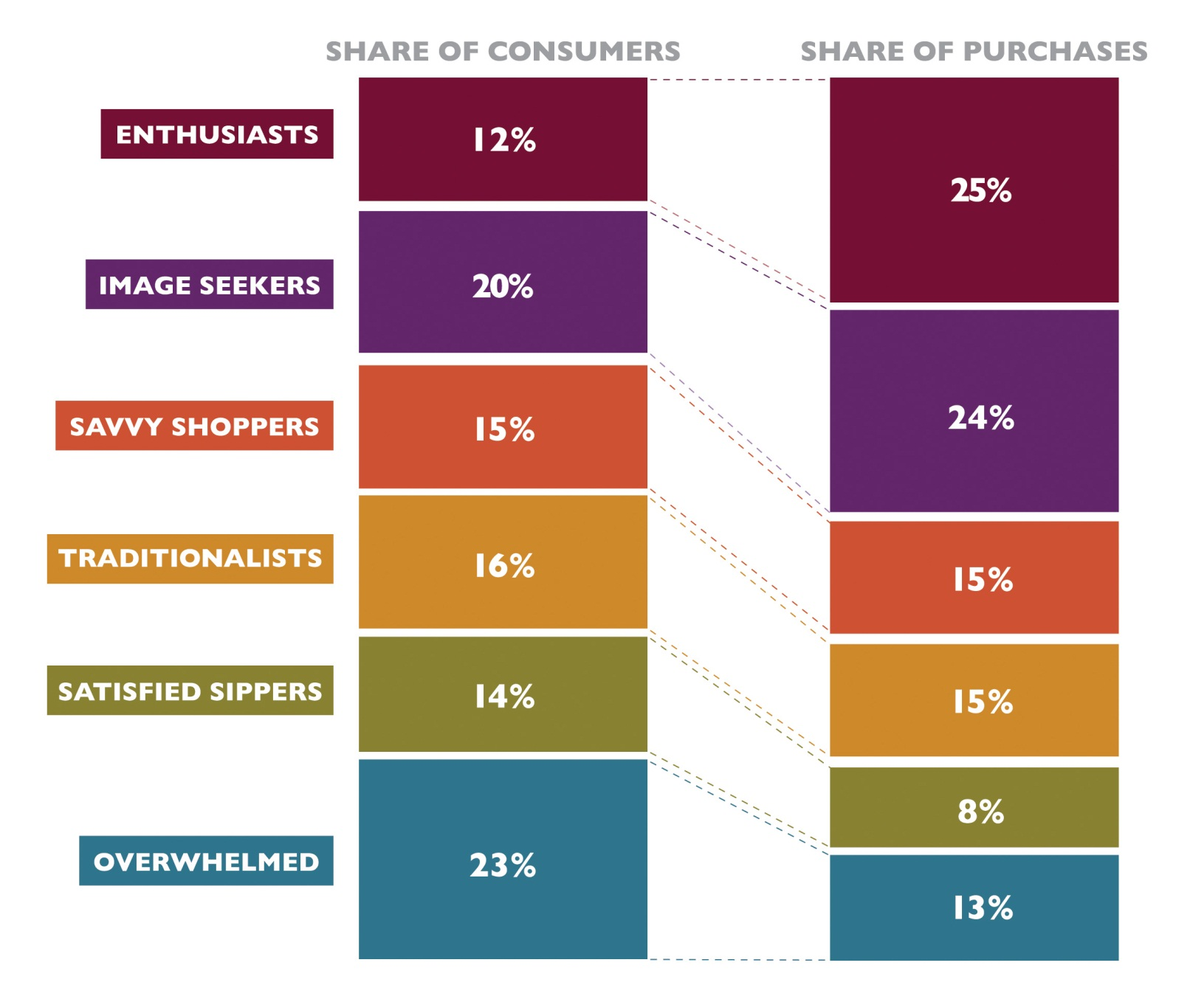

Slide 23
The 70 – 70 – 70 Rule
70% of wine sells for less than $12 / bottle
70% of wine is consumed within 3 hours of purchase
70% of wine price comes from the packaging
Implication: Tomorrow’s wines will focus on the cheap delivery of good wine to drink on the day of purchase

Slide 24
American Viticultural Areas
Terroirism has come to the US
Specific vineyards are identified for reserve wines.
There now exist many AVAs in the US
On April 23, 2012, Wisconsin Ledge AVA created–
http://www.escarpmentnetwork.org/pdf/Exhibit1_NEWineriesMap_Nov2009.pdf
12th largest AVA in the US, 320 acres of vineyards, 16th largest number of wineries in AVA
Others include 16 AVA w/in the Napa Valley (CA)
Branding idea: unique geography, soil, & climate

Slide 25
Wisconsin AVAs

Slide 26
Napa Valley AVAs

Slide 27
The Future
Traditional bottles w/ cork will be the exception
Heavy and expensive to ship
5% spoilage rate makes it unattractive
No major difference for “tonight’s” wine
Wine Cube California Chardonnay (High ratings)
Yellow Jersey Pinot Noir- lightweight, shatterproof, oxygen-barrier retains quality, 50% less greenhouse gas, easily recycled www.yellowjerseywine.com
Tetrabag – many 500 ml examples –California Rabbit
Stelvin closures – screw tops keep out air.
Wine on tap in oak barrels will become common

Slide 28
Wine Cube

Slide 29
More about the Future
Blending will continue – Use the best grapes to make the best tasting wine
High yield grape farms will dominate the market.
China will be a big player on both the production and consumption side. It has a long way to go from Great Wall Cabernet
US will import at least 50% of its wine as opportunity cost of growing grapes will cause switch to almonds and pistachios

Slide 30
Niche Markets
Family Wineries – V Sattui
Biodynamic Wineries – Benzinger
Grapes grown from specially created vines that make them climate consistent – Ledgestone’s Frontenac
“Fun” places – wine is part but not the central story – Lautenbach’s Orchard Country Market and Winery
Pro Football’s Finest

Slide 31
V Sattui – A Place to Spend the Day

Slide 32
Benziger’s Biodynamics http://www.youtube.com/watch?feature=player_embedded&v=qa2ElPaiY2A
Notes:
Created an ecosystem complete with birds, bees, horses, highland cattle, and sheep. Sheep and cattle are efficient mowers and fertilizers. Wines have received numerous awards since they completed their shift to biodynamics in 2000

Slide 33
Ledgestone – Made in Wisconsin

Slide 34
Orchard Country Market and Winery – Door County Cherries

Slide 35
Twenty Four – Charles Woodson

Slide 36
Modern Technology and Opus One
Presenting at WineFuture Hong Kong 2011, David Pearson of Opus One said, “Starting with our 2008 vintage, we have an NFC tag on each bottle under the back label, which connects consumers to a video of our winemaker. Now we envision adding an eProvenance sensor inside each case to monitor the temperature for 15 years, allowing consumers with an NFC phone to read the entire temperature history with one click. The potential to connect with our consumers and to safeguard their wine is tremendous.”
Notes:
www.nfcworld.com/2011/12/09

Slide 37
Make the Right Wine Choice – Near Field Communication http://www.youtube.com/watch?v=yK9v4YMMyLY

Slide 38
Wisconsin – US Wine Capital?
Global Warming means that production between the 30th and 40th parallel will be more difficult
More wine can be produced between the 40th and 50th parallel. More northern AVAs
Parallel 44 winery in Kewaunee notes it has many characteristics similar to Bordeaux and Tuscany (also at 44th parallel)
Perhaps Washington state is a better bet than Wisconsin - @12 million cases per year

Slide 39
Washington’s 13 AVAs

